Slide 1
Age estimation
Mark fesenko Noy boutboul

Slide 2
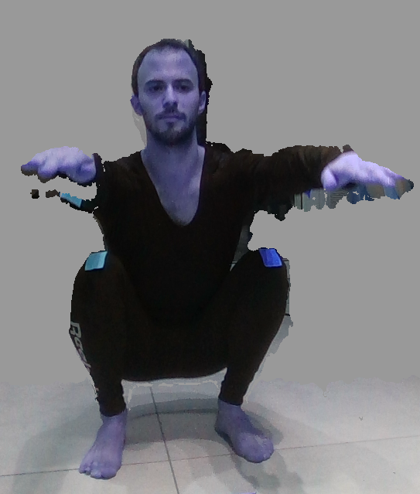
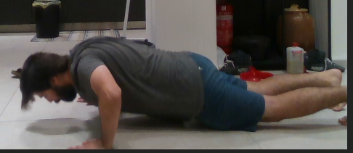
About
In this project we will be analyzing depth videos captured by intel real-sense camera where people in a variety of ages doing exercise.
The analyzation includes image detection methods, pose estimation AI, and algebra calculations in order to produce relevant data for the Age Estimation research.
Our goal is to extract accurate researchable data from the captured videos.

Slide 3
Environment & tools
Intel real-sense camera & SDK.
Python \ CPP programming language.
OpenCV python library for image processing.
Pose Estimation Algorithms such as OpenPose, AlphaPose, Cubemos, etc.

Slide 4
Schedule
Weeks 1-3: installing environment, tools, algorithms and working on a demo POC. Finalizing the project specification with the researcher.
Week 4-6: Building the program and producing the data that is required in the specification. middle presentation.
Week 7-8: Comparing and analyzing the output data with expected output data, mastering the analyzation for better results. Adding new specifications if requested.
Week 9-12: GUI?
Week 13-end: Finishing all loose ends. end presentation.

Slide 5
progress
Environment setup and installations.
Python script that breaks .bag file to depth/color frames, aligning them to one frame(to color) then saving it as png, and saving csv for each aligned frame.
Pose estimations algorithms: Cubemos, OpenPose, AlphaPose.

Slide 6
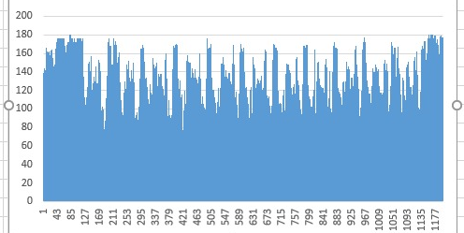
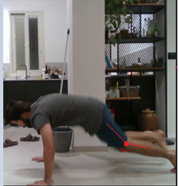
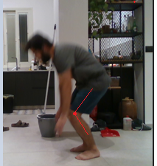
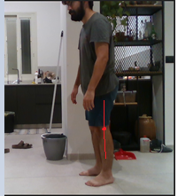
Cubemos
https://www.cubemos.com/skeleton-tracking-sdk
Burpee video, 2d analyzation
Left leg knee angle.

Slide 7
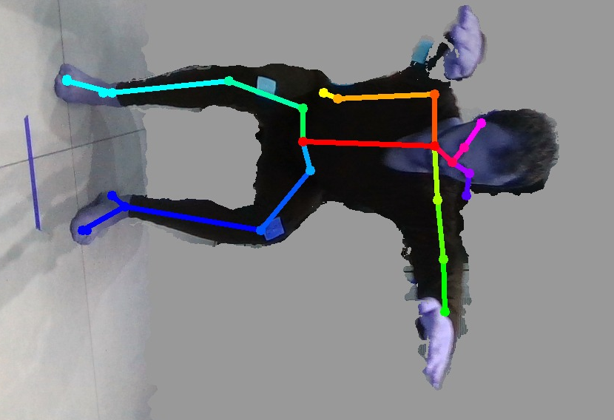
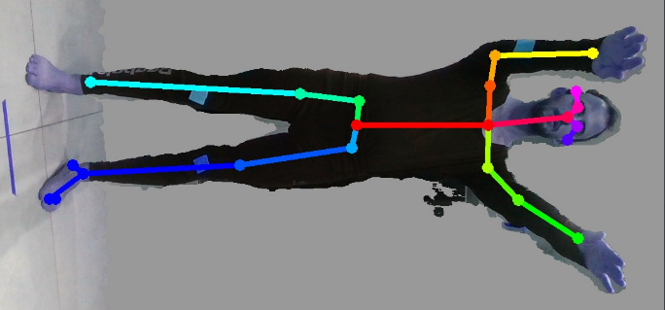
OpenPose
https://github.com/CMU-Perceptual-Computing-Lab/openpose
Unfortunately, due to poor accuracy, as you can see, we decided to switch to a more accurate algorithm.

Slide 8
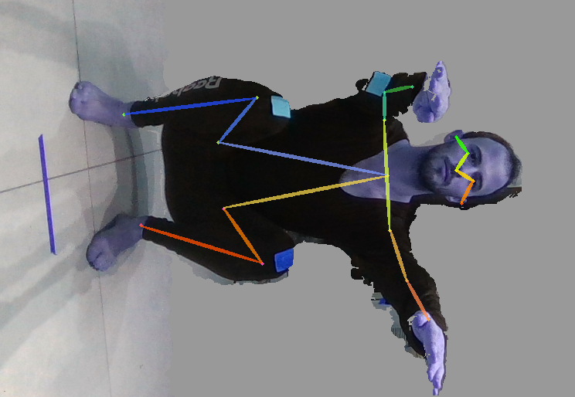
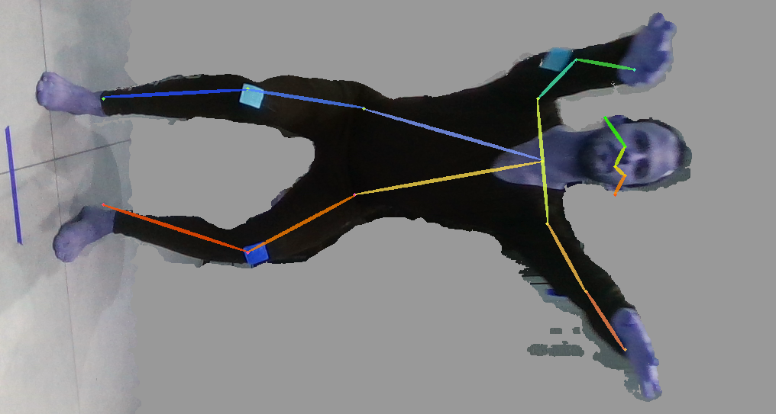
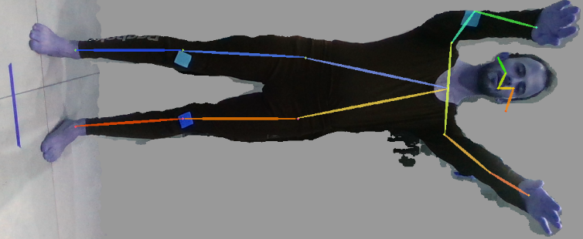
AlphaPose(FastPose model)
Using AlphaPose yielded more accurate result for body skeleton key-points

Slide 9
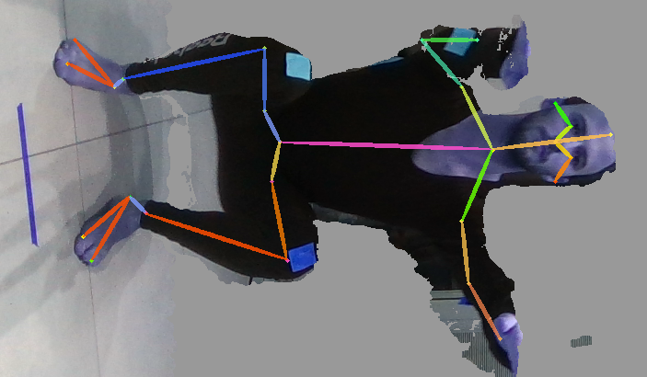
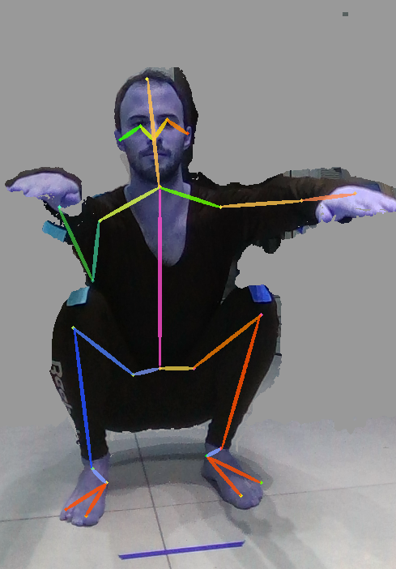
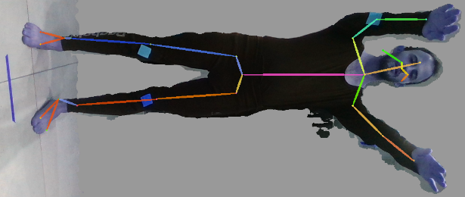
AlphaPose(Halpe model)
After discussing the specifications with Mayaan, we were still missing some key body points. We needed model with different skeleton key points. So we switched the “FastPose” model to “Halpe” model:

Slide 10
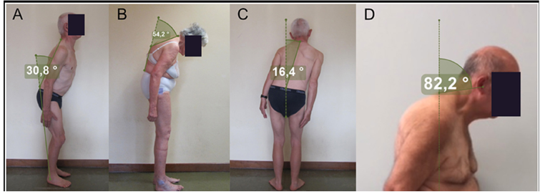
Analyzing plan
In order to calculate A, we plan to calculate the angle between baseSpine to ankle vector and baseSpine to neck vector.
In B and D we will use stickers on the curve point detect it and calculate the required angle.
In C we will create a perpendicular line from the crotch to the ground and calculate the angle.
Camera has to be leveled with the floor.

